Slide 1
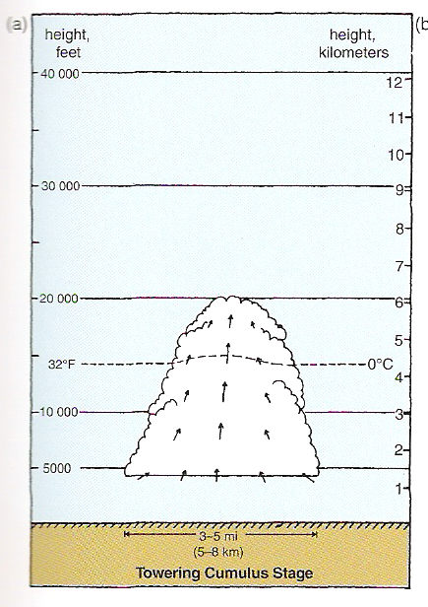
Convection Initiation
Markowski and Richardson (2010), their Fig. 8.8a

Slide 2
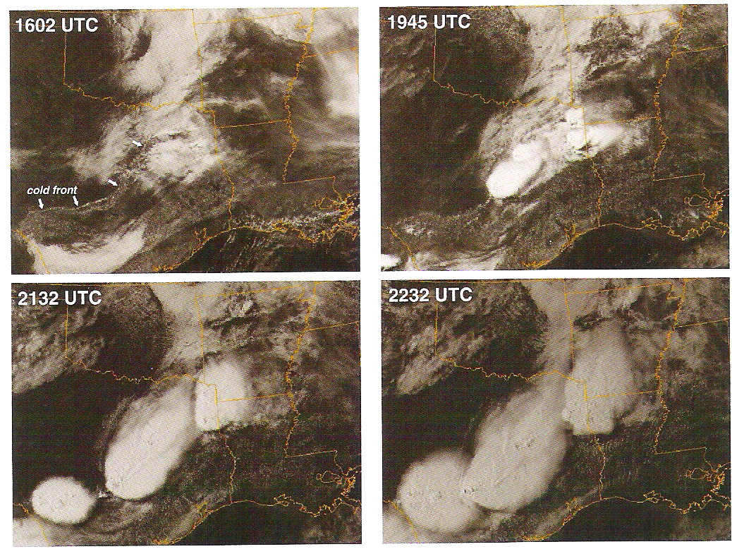
Convection Initiation Along Boundaries
Markowski and Richardson (2010), their Fig. 7.2

Slide 3
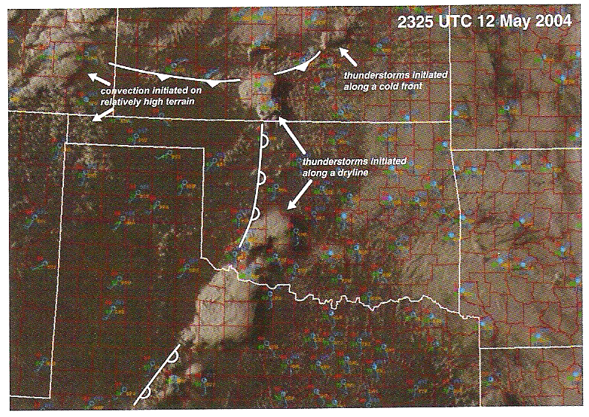
Convection Initiation Along Boundaries
Markowski and Richardson (2010), their Fig. 7.10

Slide 4
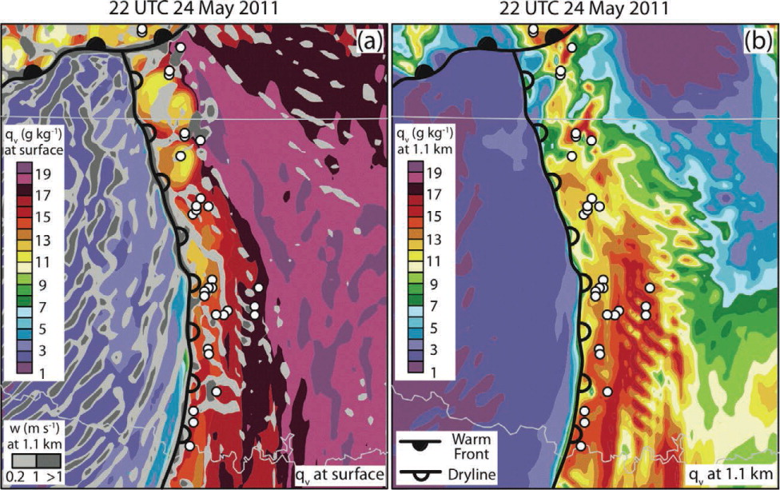
Mesoscale Complexities of Initiation
Kain et al. (2013, BAMS), their Fig. 5

Slide 5
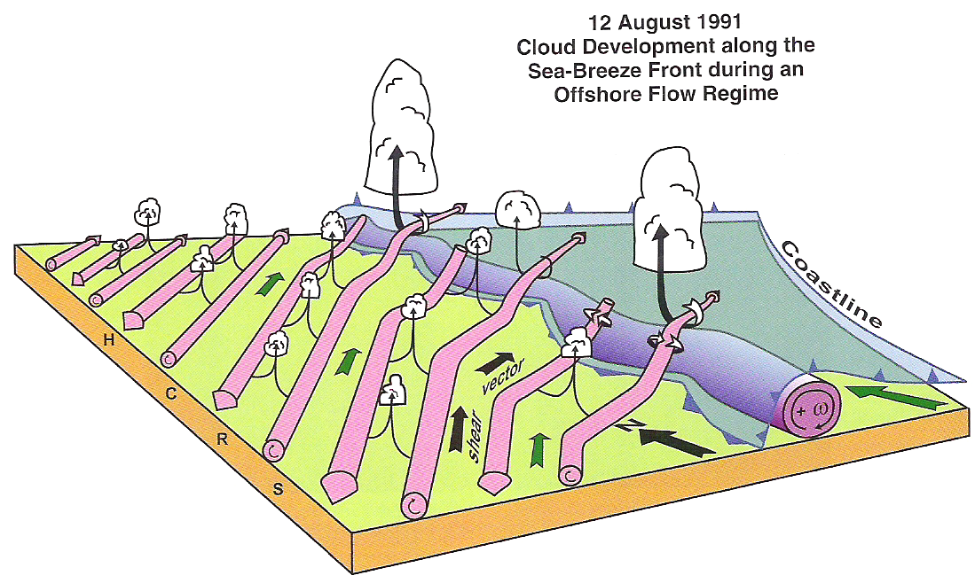
Mesoscale Complexities of Initiation
Markowski and Richardson (2010), their Fig. 7.11

Slide 6
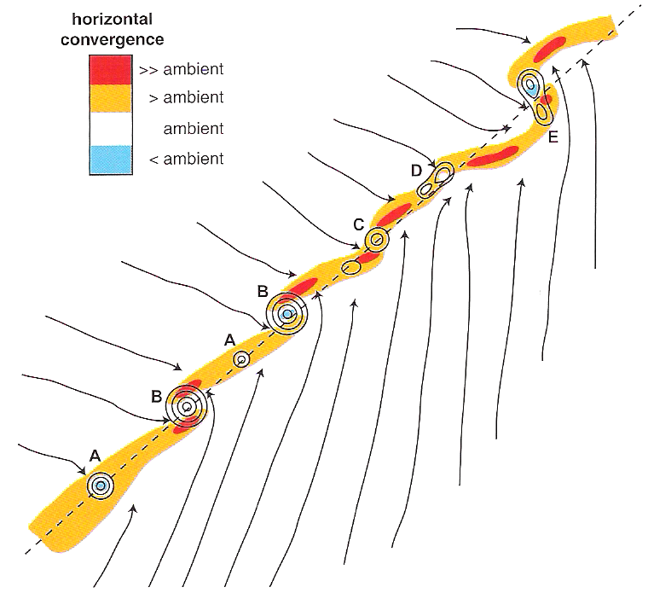
Mesoscale Complexities of Initiation
Markowski and Richardson (2010), their Fig. 7.13

Slide 7
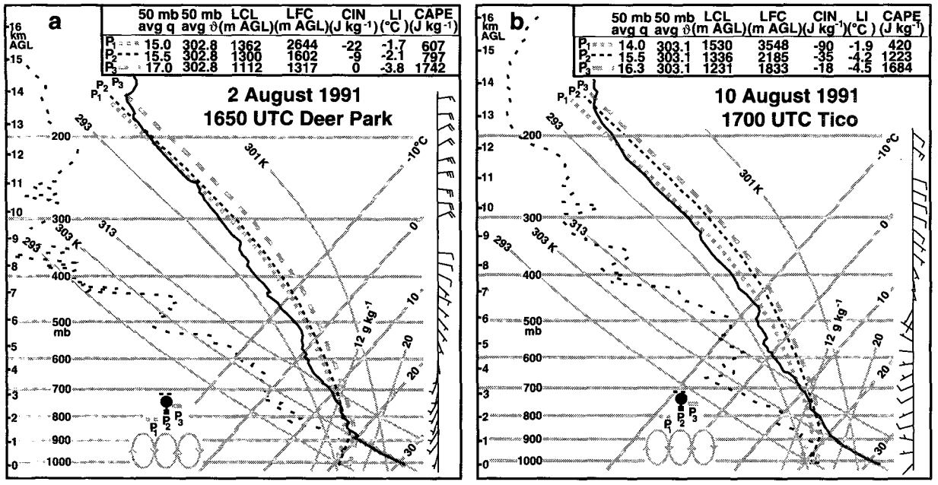
Mesoscale Inhomogeneity
Weckwerth et al. (1996, Mon. Wea. Rev.), their Fig. 9

Slide 8
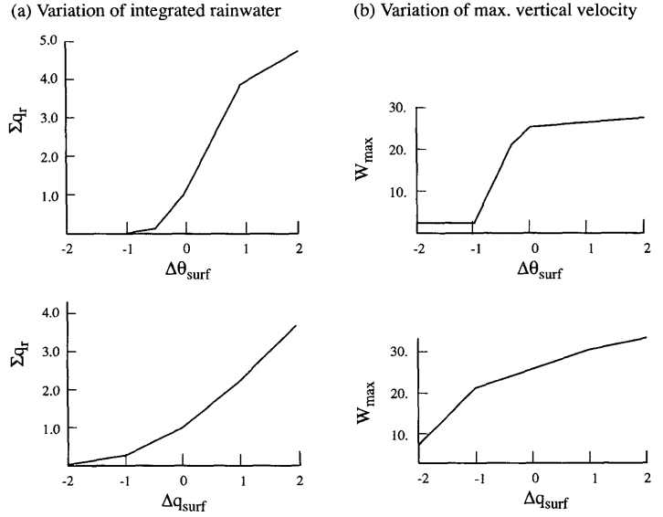
Mesoscale Inhomogeneity
Crook (1996, Mon. Wea. Rev.), their Fig. 8

Slide 9
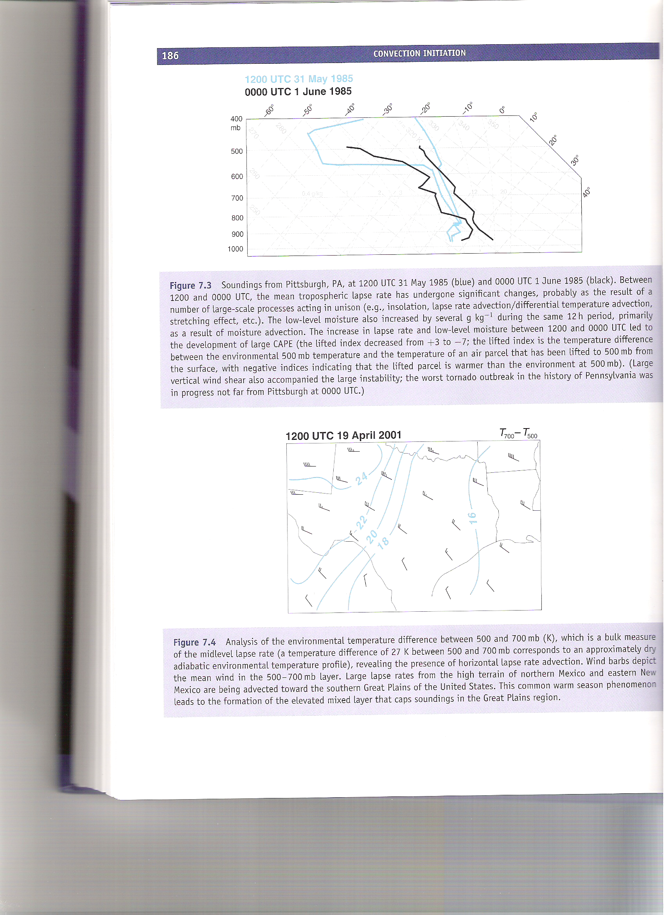
Surface-Based Initiation Vertical Profile
Markowski and Richardson (2010), their Fig. 7.3

Slide 10
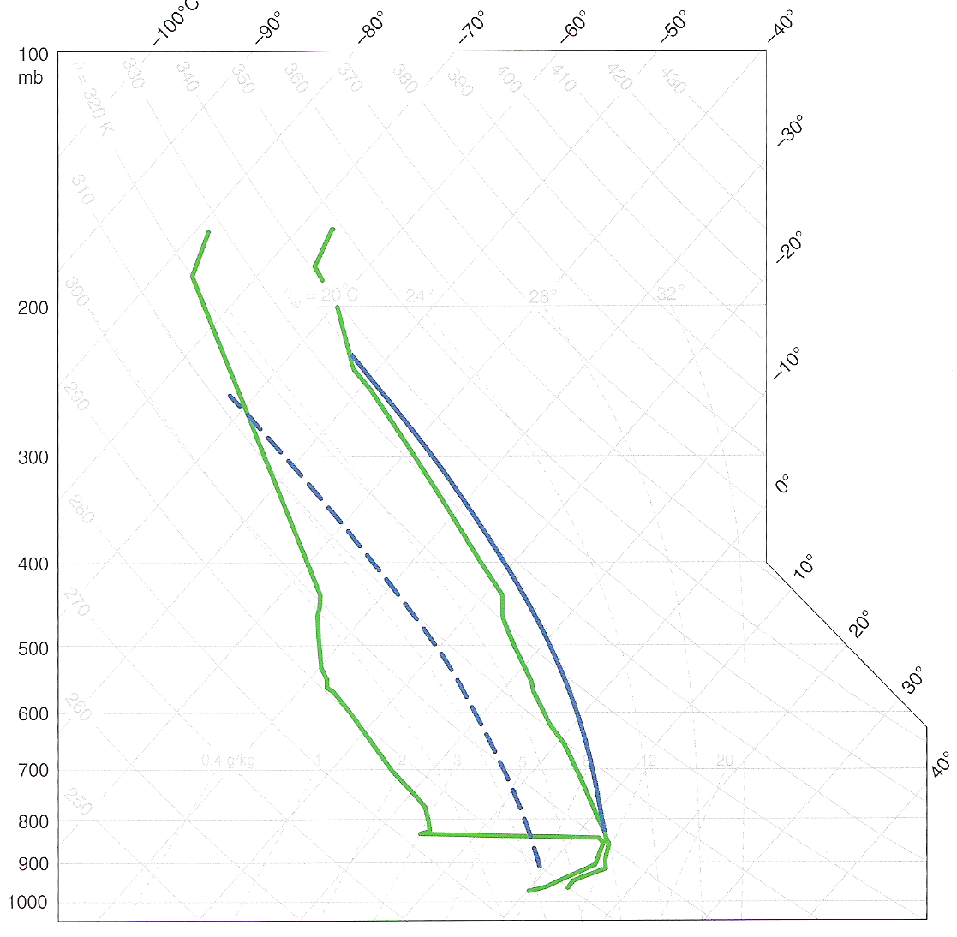
Elevated Initiation Vertical Profile
Solid: parcel trace for parcel originating near 850 hPa
Dashed: parcel trace for parcel originating near the surface
Markowski and Richardson (2010), their Fig. 7.22

Slide 11
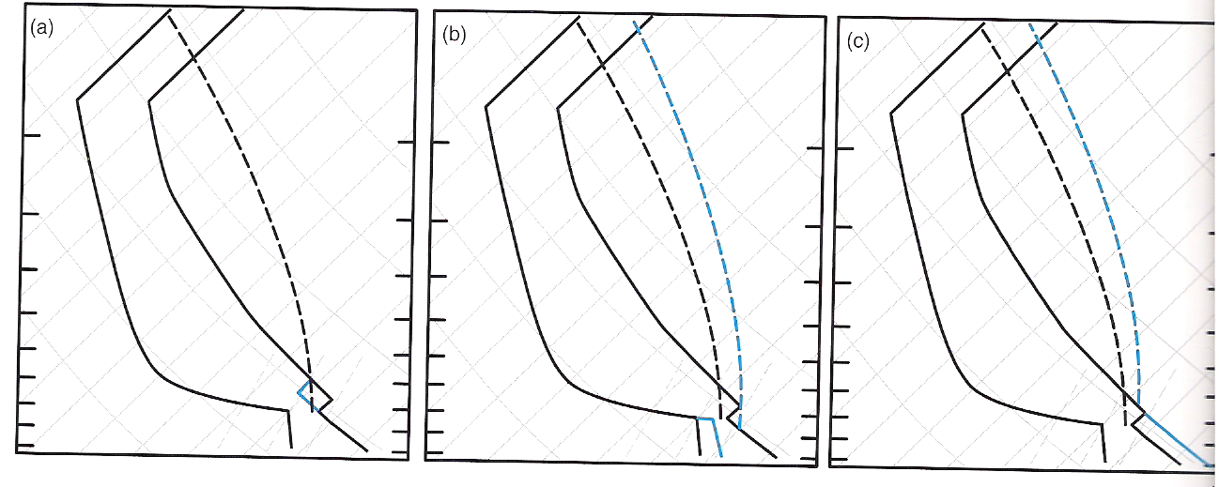
Initiation-Supporting Sounding Changes
Lifting an inversion layer
Moistening the boundary layer
Warming the boundary layer
Markowski and Richardson (2010), their Fig. 7.9

Slide 12
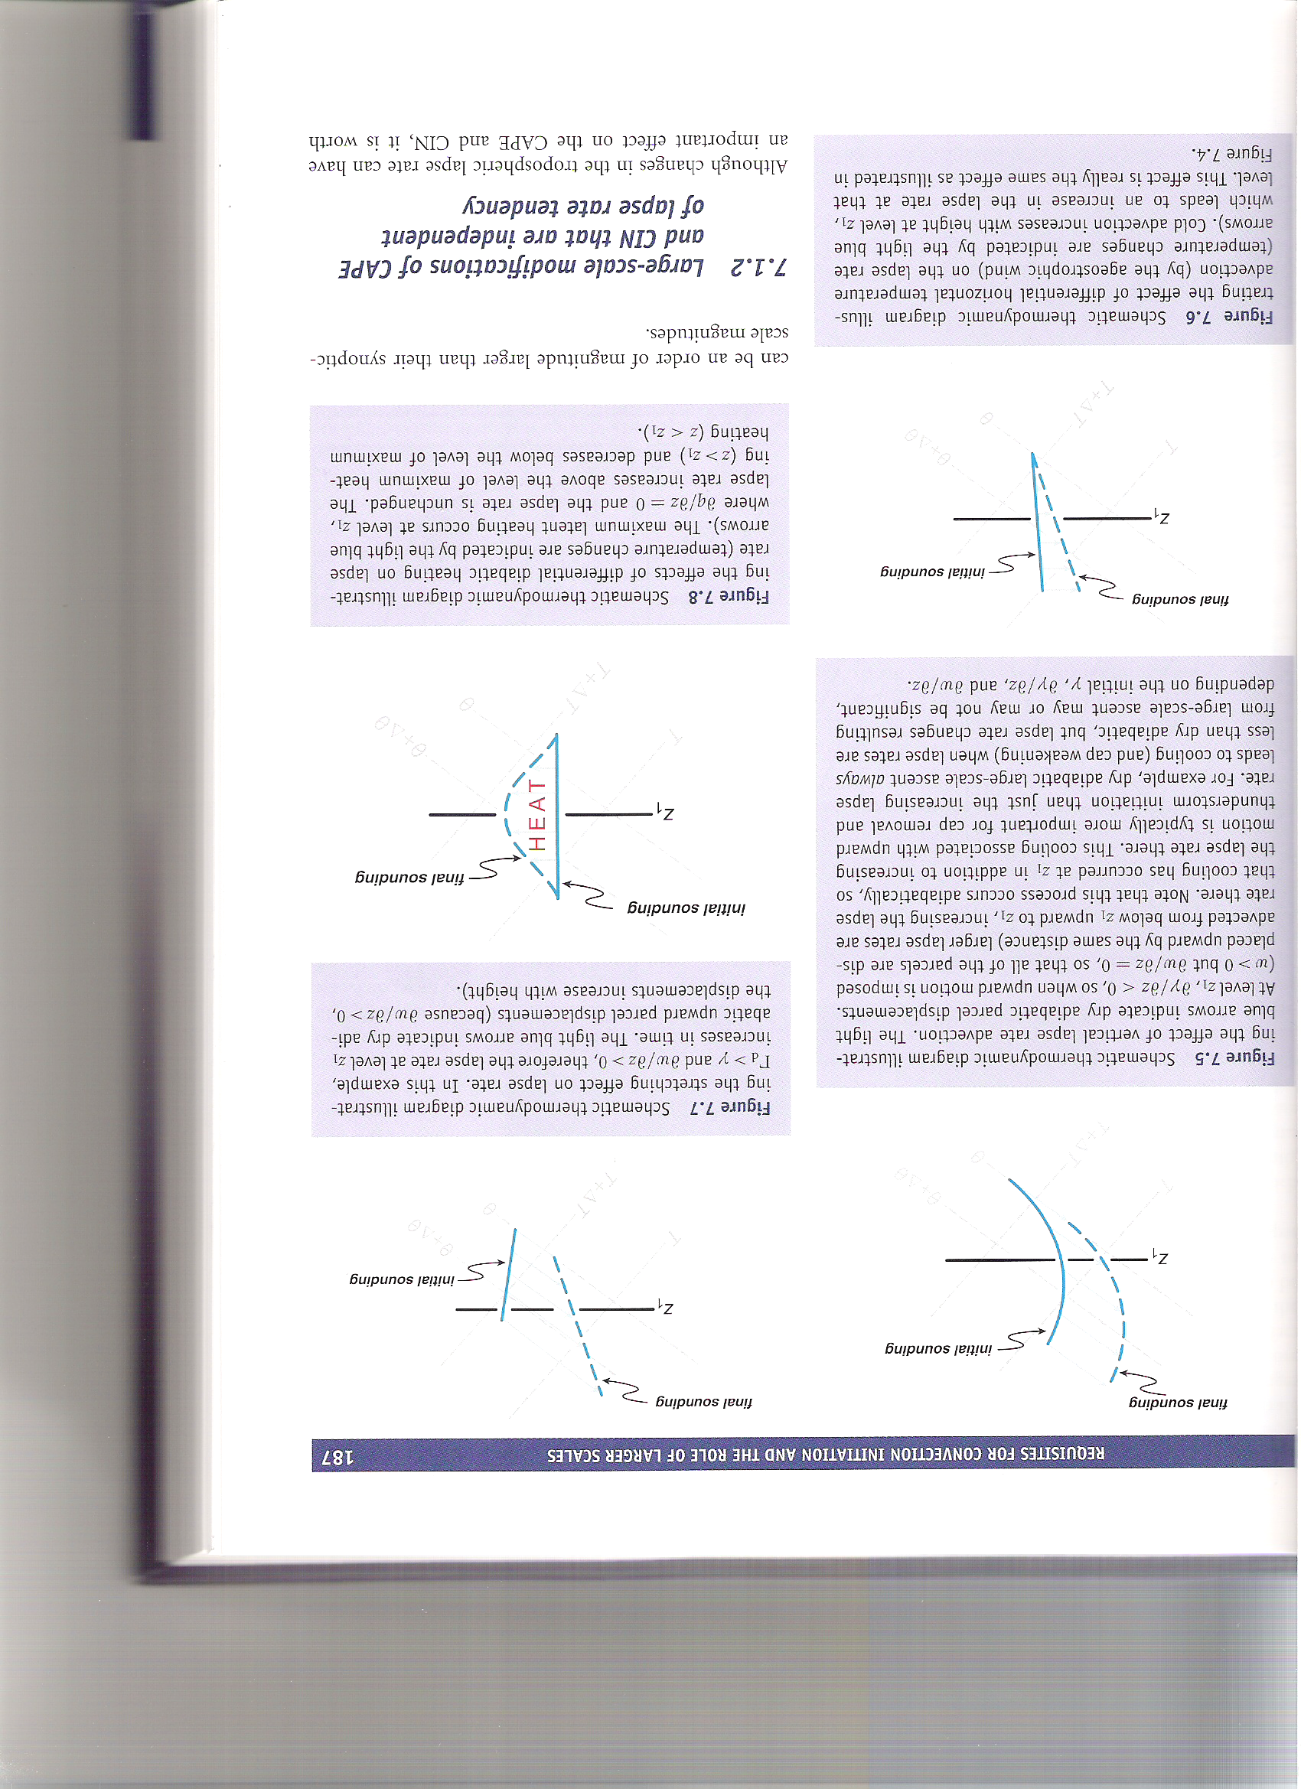
Lapse Rate Tendency Examples
Horizontal lapse rate advection
Differential horizontal temperature advection
Markowski and Richardson (2010), their Figs. 7.4 and 7.6

Slide 13
Lapse Rate Tendency Examples
Vertical lapse rate advection (layer lifting)
Stretching term
Markowski and Richardson (2010), their Figs. 7.5 and 7.7

Slide 14
Lapse Rate Tendency Examples
Differential diabatic heating term
Markowski and Richardson (2010), their Fig. 7.8

Slide 15
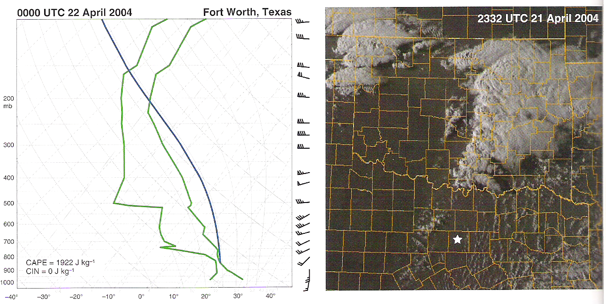
Insufficiency of CAPE and CIN
Markowski and Richardson (2010), their Fig. 7.15

Slide 16
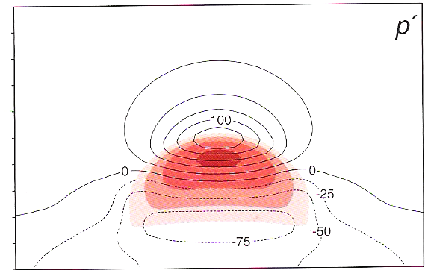
Insufficiency of CAPE and CIN
Markowski and Richardson (2010), their Fig. 3.1

Slide 17
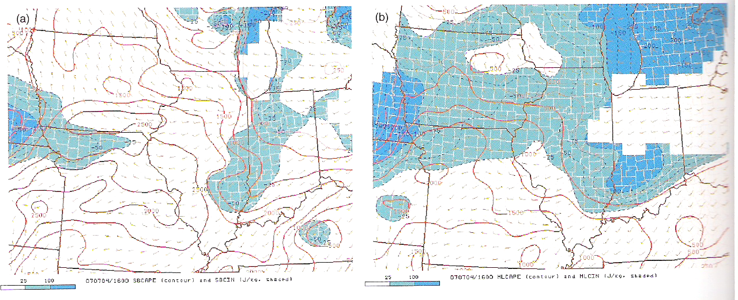
Insufficiency of CAPE and CIN
Surface-based CAPE/CIN
100 hPa mixed-layer CAPE/CIN
Markowski and Richardson (2010), their Fig. 7.18

Slide 18
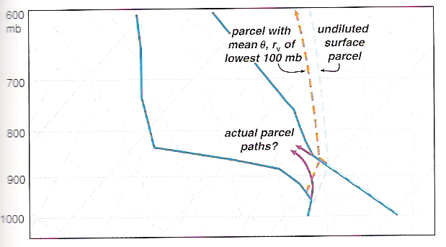
Insufficiency of CAPE and CIN
Markowski and Richardson (2010), their Fig. 7.19

Slide 19
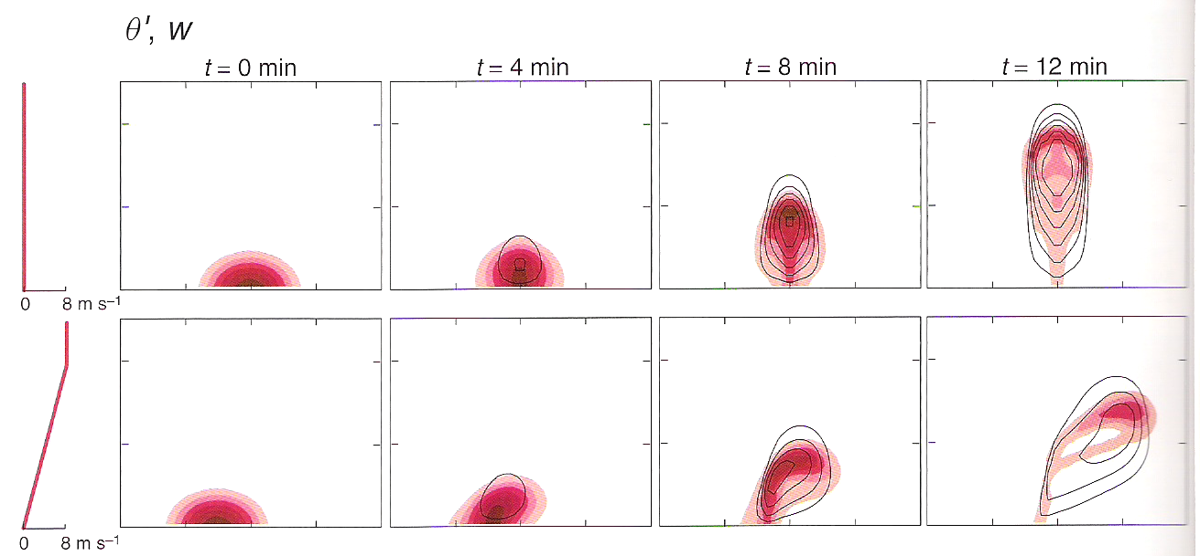
Insufficiency of CAPE and CIN
Markowski and Richardson (2010), their Fig. 7.20 (top)

Slide 20
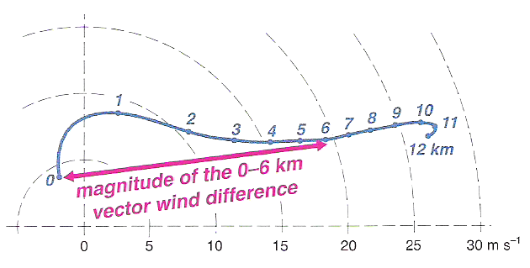
Definition of Vertical Wind Shear
Markowski and Richardson (2010), their Fig. 8.1

Slide 21
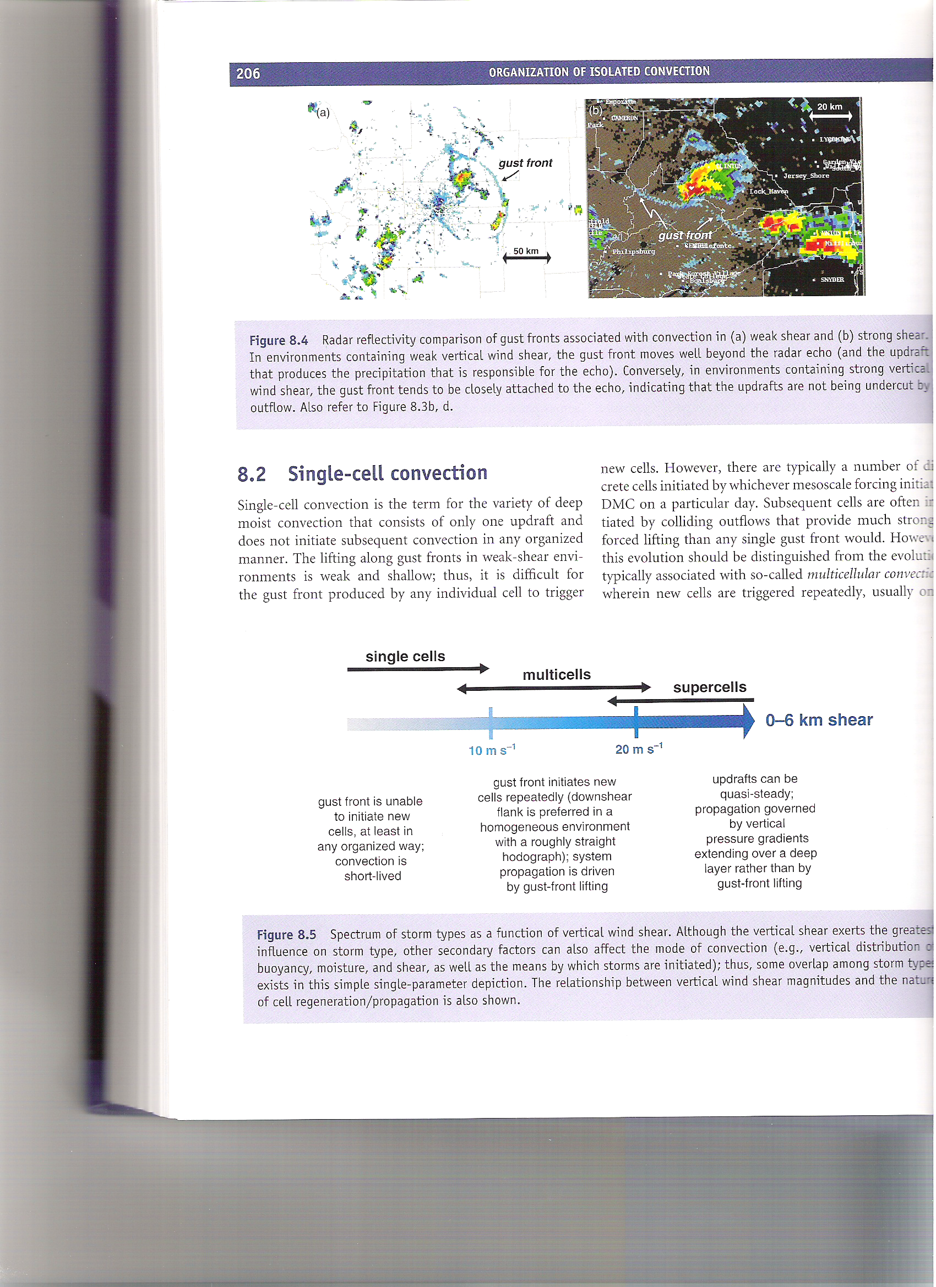
Cell Type Dependence on Vertical Wind Shear
Markowski and Richardson (2010), their Fig. 8.5

Slide 22
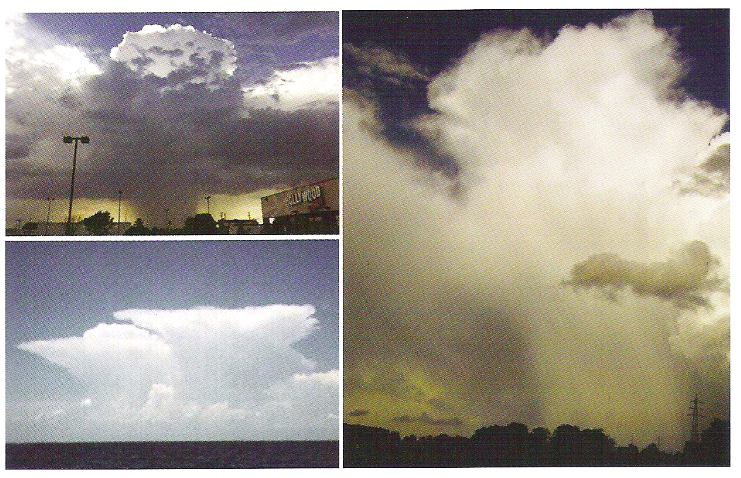
Single Cell Convection
Markowski and Richardson (2010), their Fig. 8.6

Slide 23
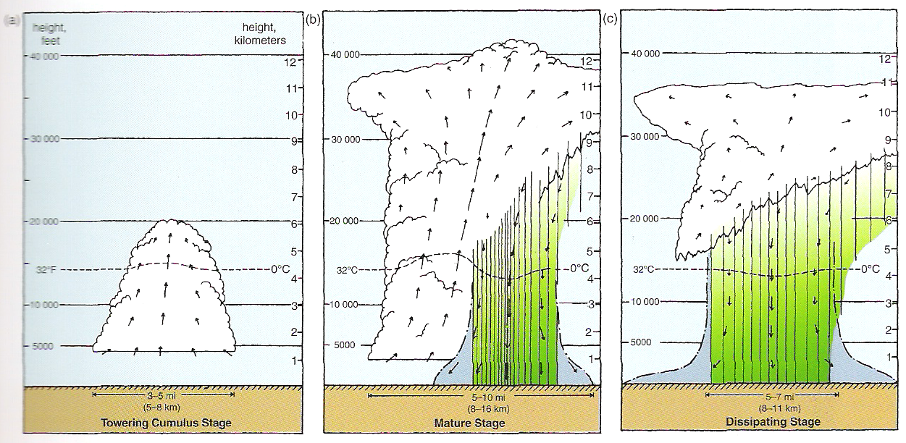
Single Cell Convection
Markowski and Richardson (2010), their Fig. 8.8

Slide 24
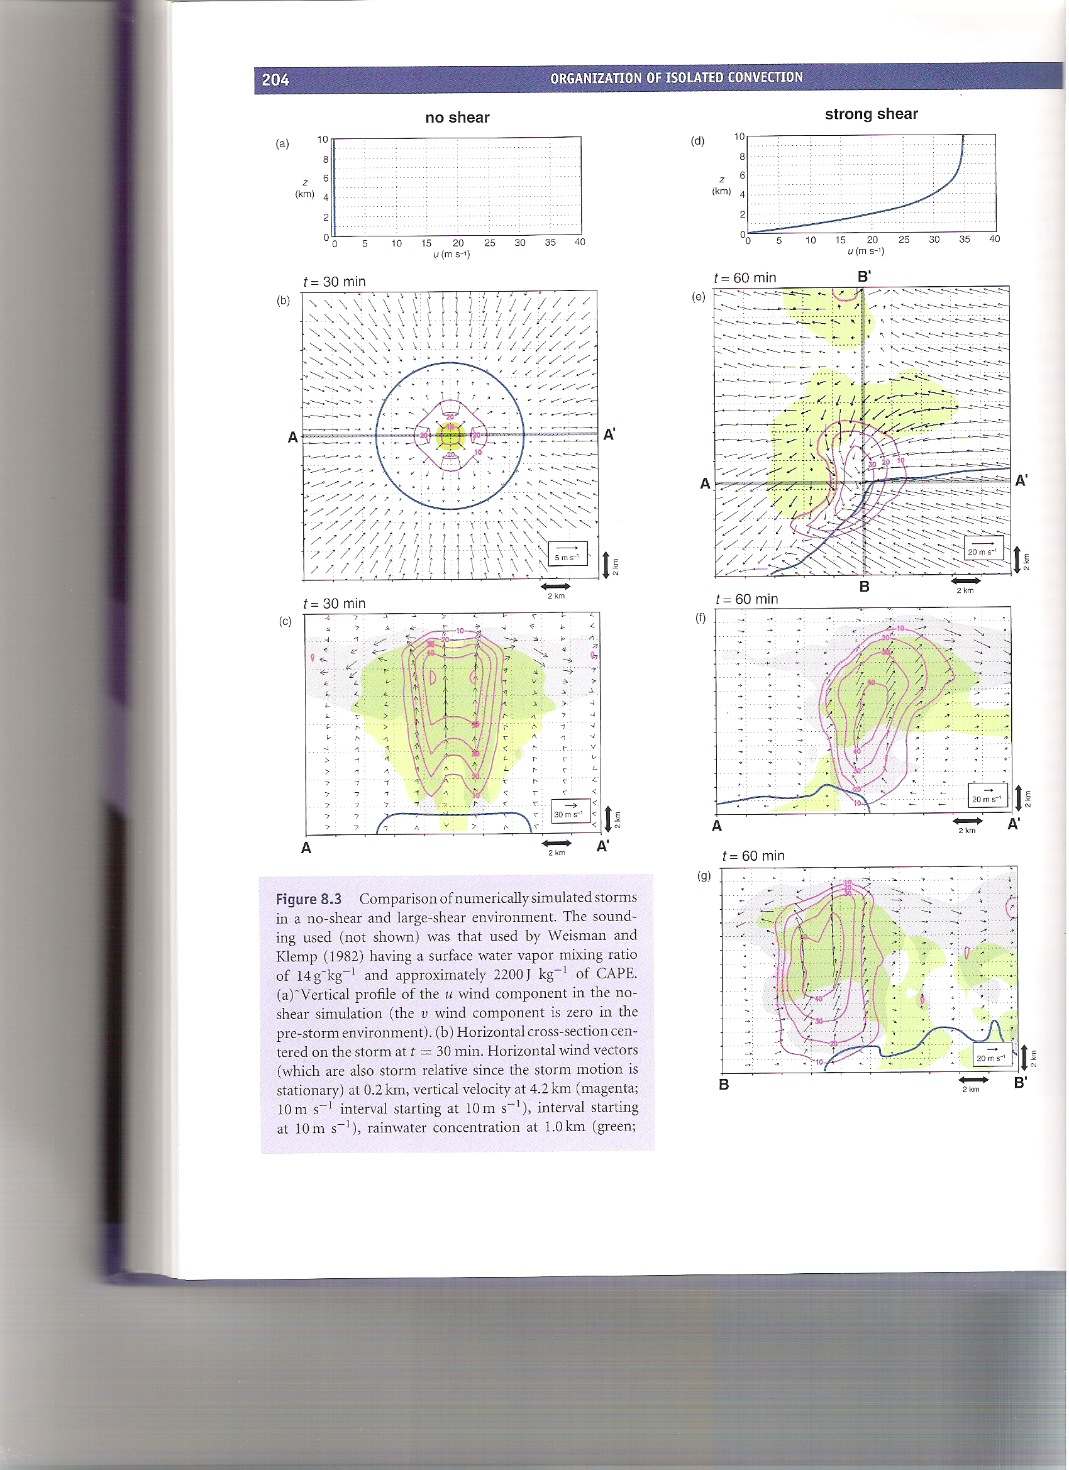
Single Cell Convection
Blue: outflow boundary
Pink: vertical motion
Green: precipitation
Grey: simulated cloud
Blue: outflow boundary
Pink: mid-level vertical motion
Green: low-level precipitation
Markowski and Richardson (2010), their Fig. 8.3(b,c)

Slide 25
Single Cell Convection
Markowski and Richardson (2010), their Fig. 8.4(left)

Slide 26
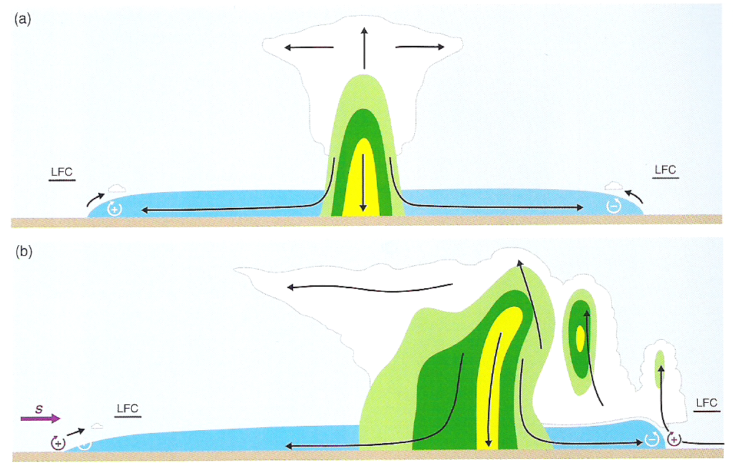
Single vs. Multicell Convection
Single Cell
Multicell
Markowski and Richardson (2010), their Fig. 8.12

Slide 27
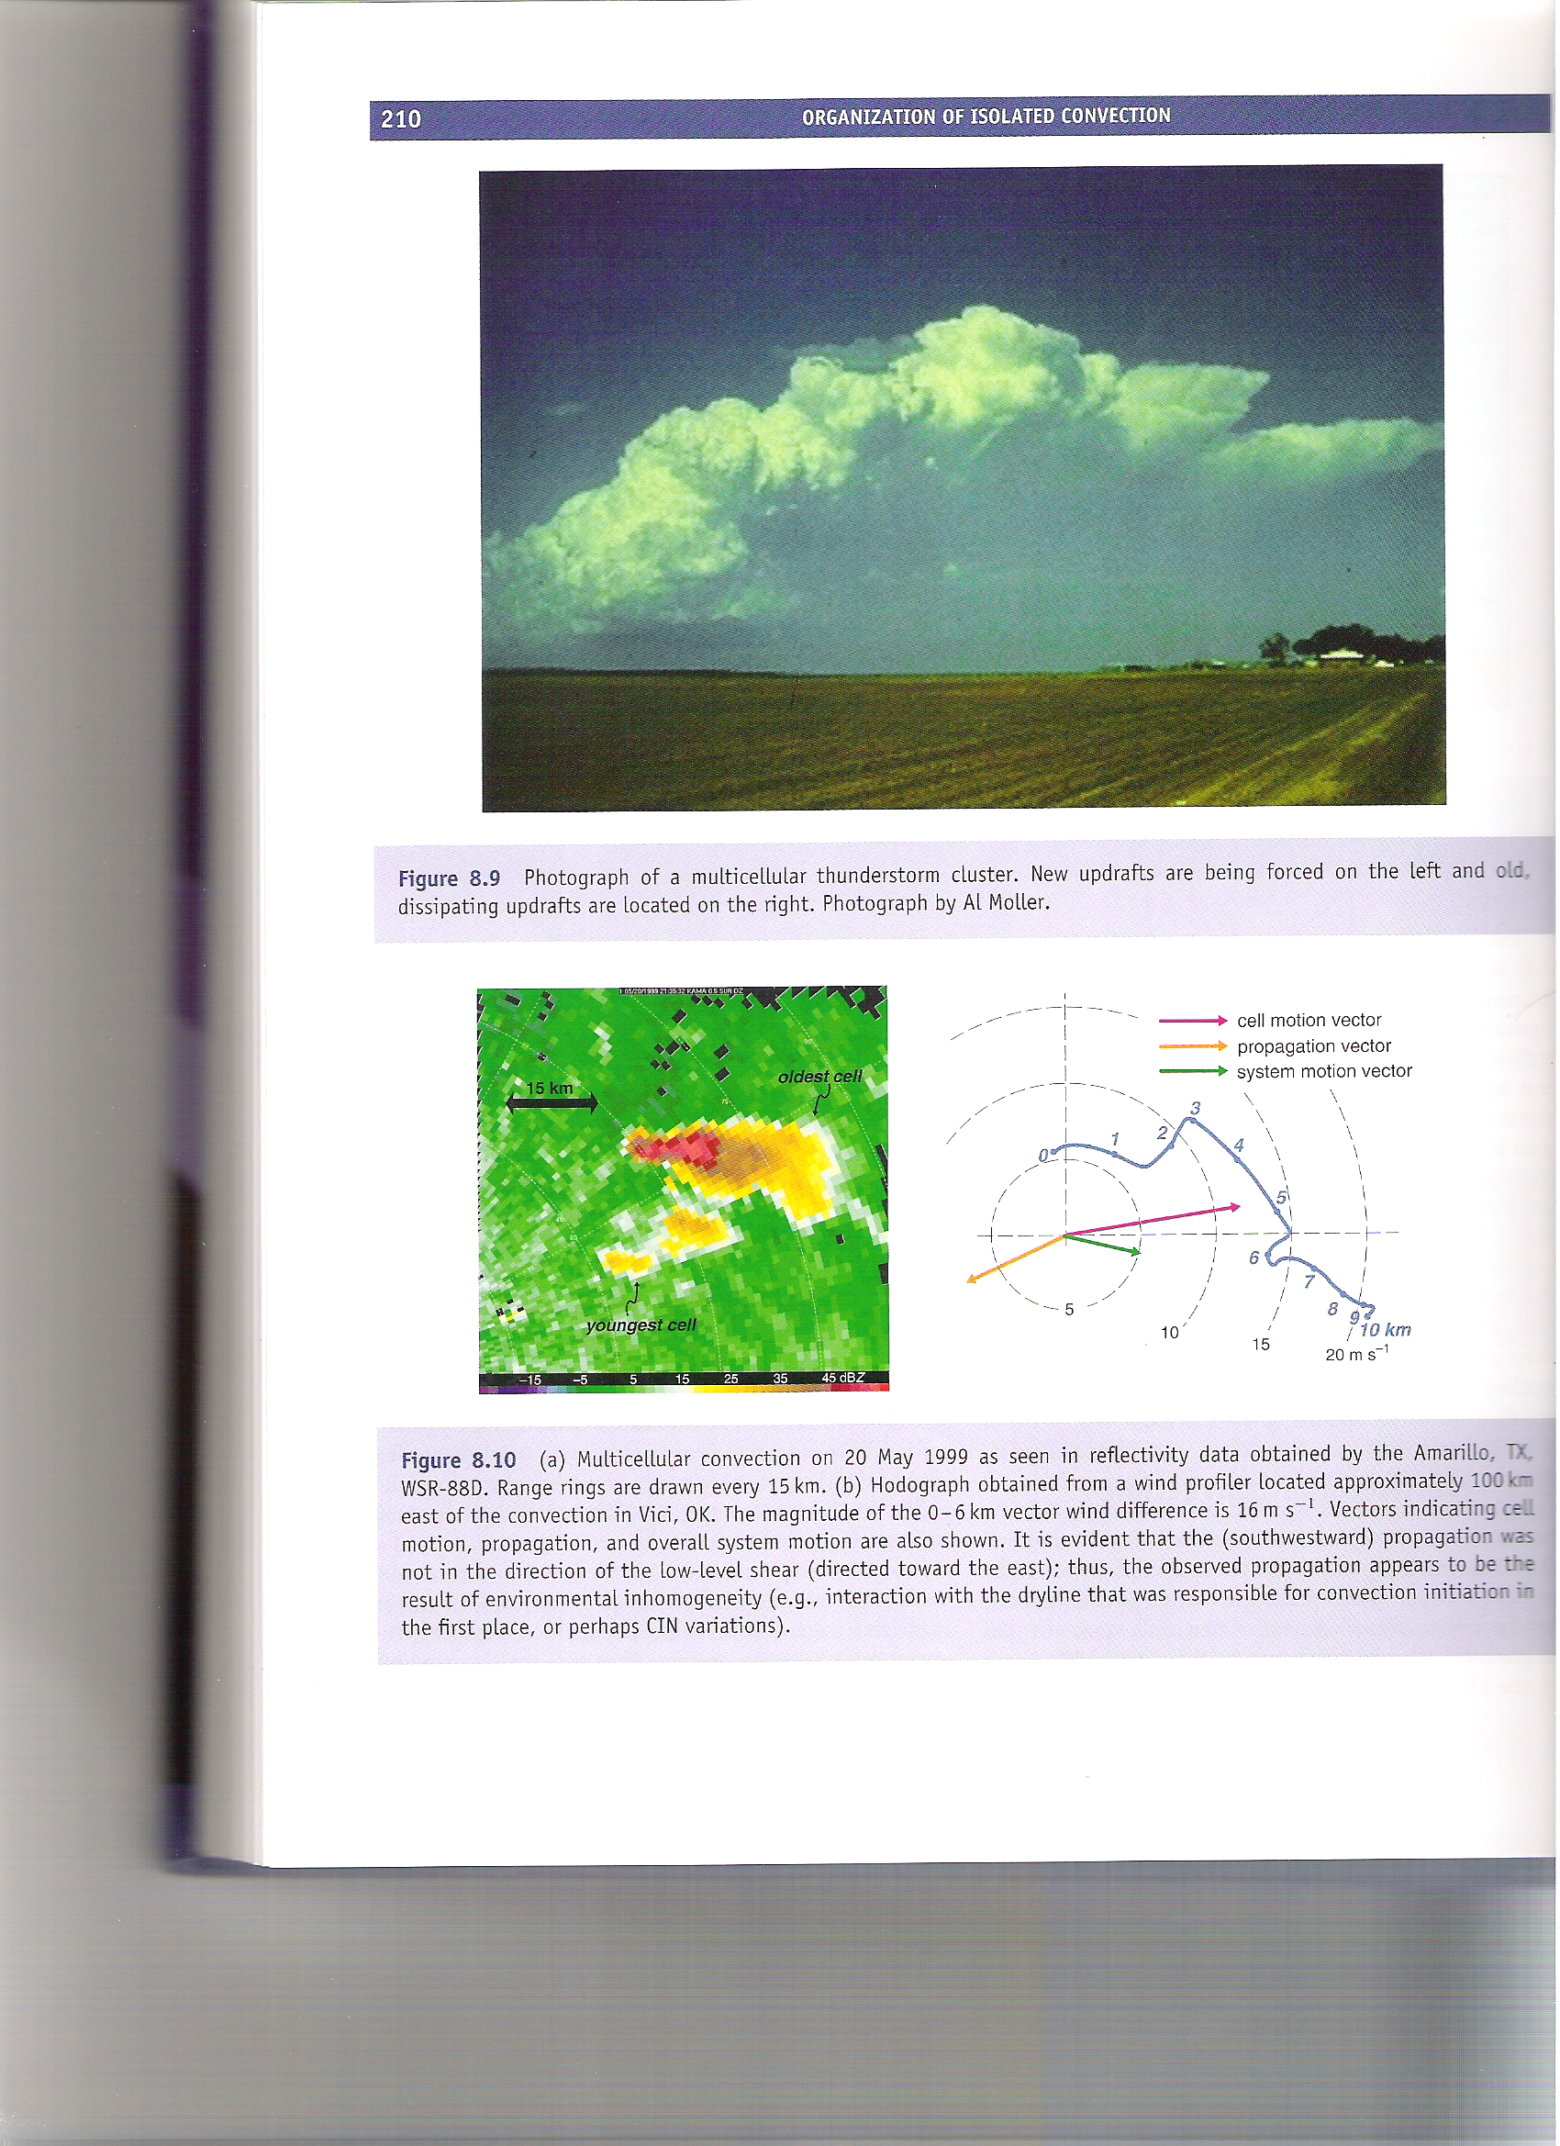
Multicell Convection
newer cells older cells
Markowski and Richardson (2010), their Fig. 8.9

Slide 28
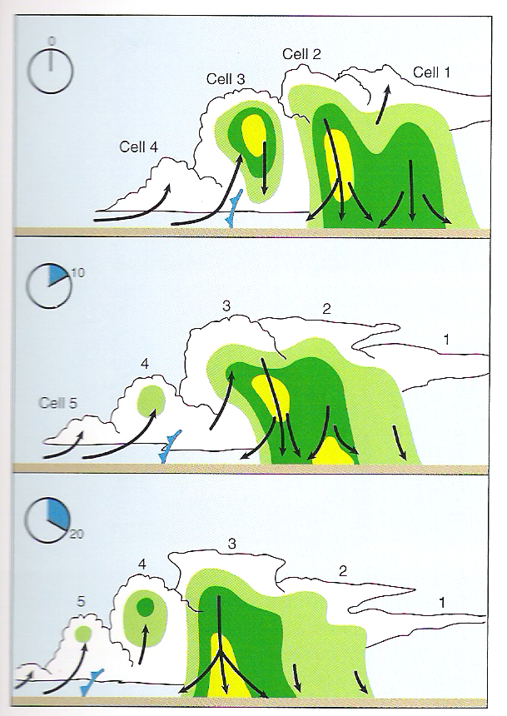
Multicell Convection
Markowski and Richardson (2010), their Fig. 8.11

Slide 29
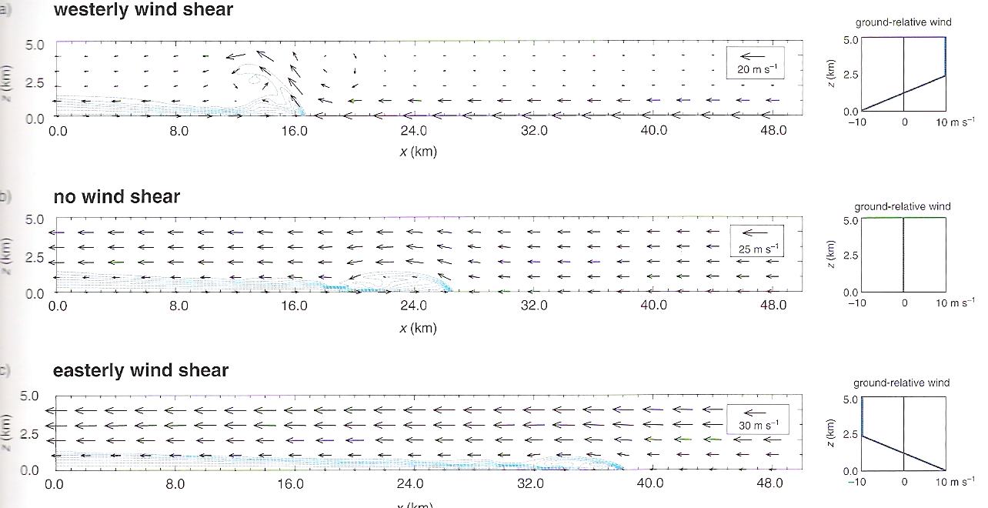
Density Current Lifting in Shear
Multicell development is favored along the portion of the outflow boundary where the environmental wind shear vector is largely perpendicular to the outflow boundary.
Markowski and Richardson (2010), their Fig. 5.31

Slide 30
Multicell Convection
0-2.5 km shear vector
New cells preferentially develop on the southwest flank, closer to the dry line and lower CIN, rather than to the east (where the gust front and low-level shear vector are best aligned).
Markowski and Richardson (2010), their Fig. 8.10

Slide 31
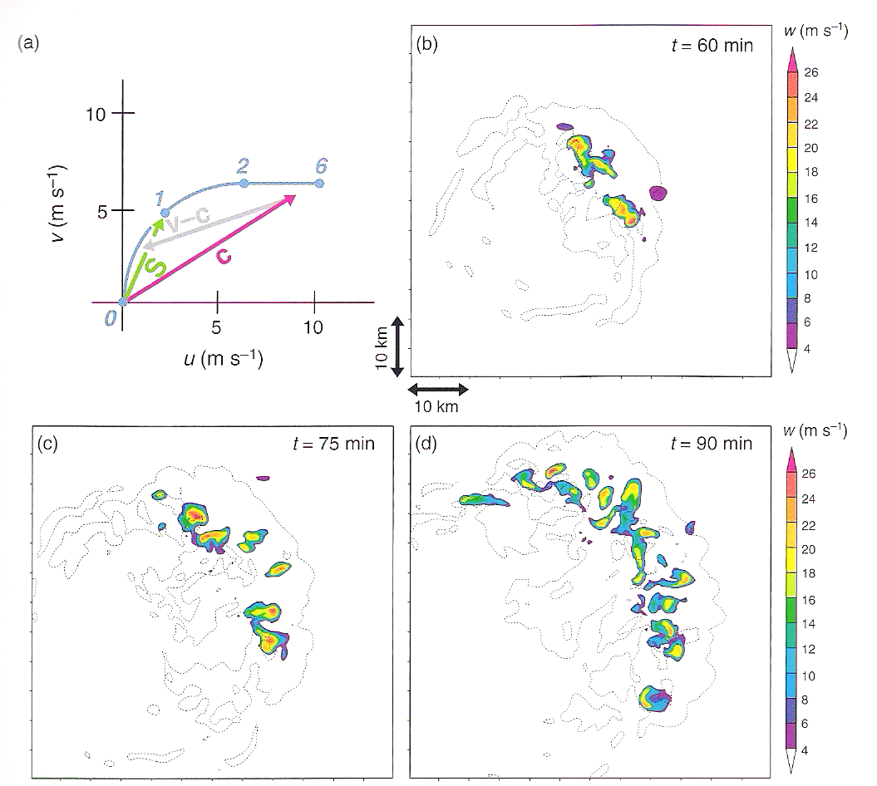
Multicell Convection
Multicell development is favored in two locations:
north, where the shear vector is perpendicular to the outflow boundary
east, where the near-surface storm-relative wind is perpendicular to the outflow boundary
Markowski and Richardson (2010), their Fig. 8.13

